Slide 1
with
STEP 1 – save the designs in Powerpoint to your computer
STEP 2 – choose your design
STEP 3 - click and move any elements - make bigger or smaller to create your own template or keep it as is
STEP 4 – add your own menu or click here for ideas
STEP 5 – add your own pub logo and contact / social media details

Slide 2
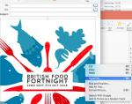
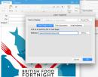
with
You can change background colours easily to fit with your interior
Create emails using the designs. Simply right click over the image once you have added your own information , then paste into an email. Add a hyperlink to your website and send to you customers
Transform menu templates into posters quickly and easily by moving elements around the page

Slide 3
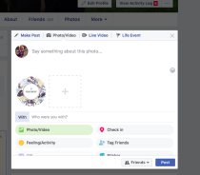
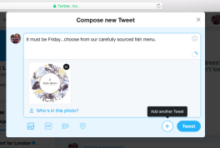
with
Use the designs to create engaging social media content.
Click on the image from the template you want to use, right click and save as a jpeg to your files then upload onto the social media of your choice

Slide 4
Key Calendar Dates
Jan – Mar
Chinese New Year
Valentine’s Day
St Patricks Day
Mothering Sunday
British Pie Week 5 – 11th March
Fish Friday
Easter
Apr – June
Fathers Day 17th June
Beer Day Britain 15th June
British Sandwich Week
Bottomless Brunch
Tapas Tuesday
Italian/curry night
You can change background colours easily to fit with your interior
Jul –Sep
British Food Fortnight
Wimbledon Fortnight 2-15th July
Scottish Food & Drink Fortnight Sep 1 – 16th
Mr. Hyde National Burger Day- August 23rd
World cup
Oct – Dec
Halloween
UK Sausage Week 29th Oct – 4th Nov
Vegan Day – 1st November
Bonfire Night
Christmas
New Years Eve
Burns 25th Jan 2019
Chinese New Year
Visit the downloads section of the McCain Foodservice website for more designs

Slide 6
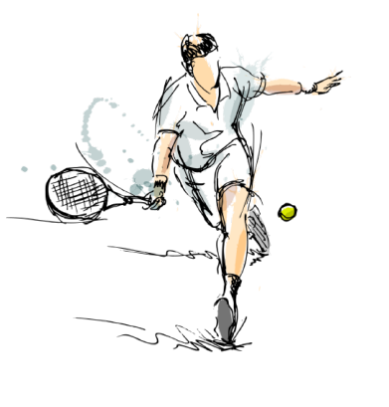

Slide 7
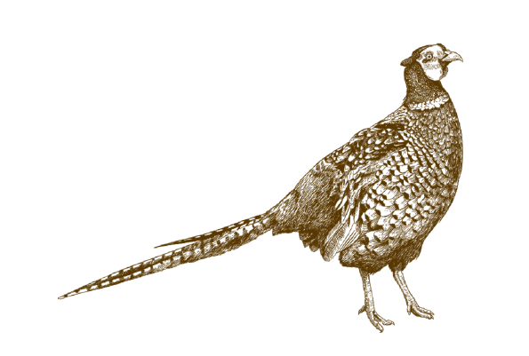
Book now
Tel: 01933 355555 or visit www.thegriffinstamwick.co.uk

Slide 9
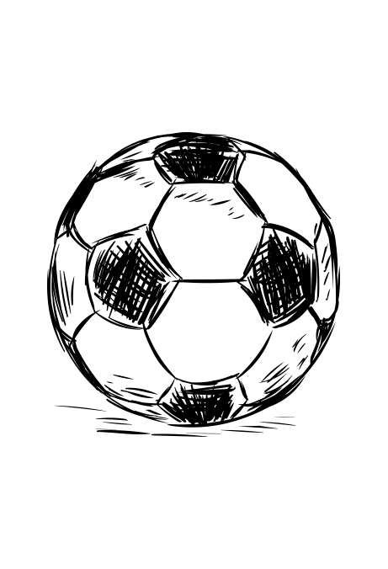
Poutine Fries,
Italian wedges,
Stir Fries
Smokey Joe Sweet Potato Fries
Sweet & Salty
Piggin’chips
Chilli chips (v)

Slide 10
Click here for topped chip recipes and ideas

Slide 11
Book now
Tel: 01933 355555 or visit www.thegriffinstamwick.co.uk

