Slide 1



with
STEP 1 – save the designs in Powerpoint to your computer
STEP 2 – choose your design
STEP 3 - click and move any elements - make bigger or smaller to create your own template or keep it as is
STEP 4 – add your own menu
or click here for ideas
STEP 5 – add your own pub logo and contact / social media details

Slide 2
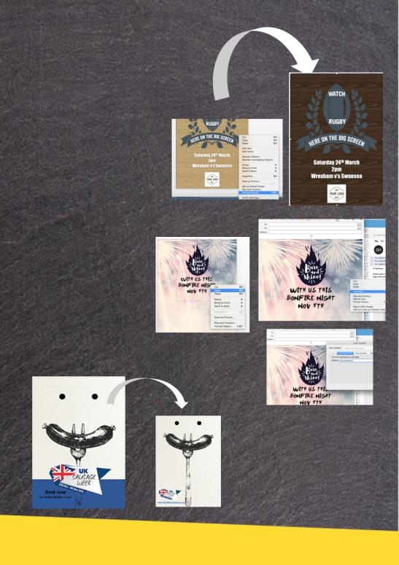


with
You can change background colours easily to fit with your interior
Create emails using the designs. Simply right click over the image once you have added your own information to, then paste into an email. Add a hyperlink to your website and send to you customers
Transform menu templates into posters quickly and easily by moving elements around the page

Slide 3
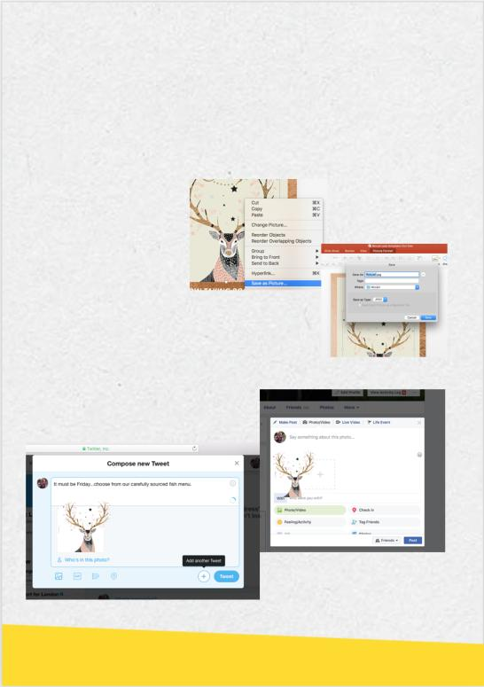

with
Use the designs to create engaging social media content.
Click on the image from the image you want to use, right click and save as a jpeg to your files then upload onto the social media of your choice

Slide 4


Key Calendar Dates
Jan – Mar
Chinese New Year
Valentine’s Day
St Patricks Day
Mothering Sunday
British Pie Week 5 – 11th March
Fish Friday
Easter
Apr – June
Fathers Day 17th June
Beer Day Britain 15th June
British Sandwich Week
Bottomless Brunch
Tapas Tuesday
Italian/curry night
Jul –Sep
British Food Fortnight
Wimbledon Fortnight 2-15th July
Scottish Food & Drink Fortnight
Sep 1 – 16th
Mr. Hyde National Burger Day- August 23rd
World cup
Sunday roast
Oct – Dec
Halloween
UK Sausage Week 29th Oct – 4th Nov
Vegan Day- 1st Nov
Bonfire Night
Christmas
New Years Eve
Burns Night- 25th Jan 2019
Chinese New year
Rugby
Visit the downloads section of the McCain Foodservice website for more designs

Slide 5




Book now
Tel: 01933 355555 or visit www.thegriffinstamwick.co.uk

Slide 6


Book now
Tel: 01933 355555 or visit www.thegriffinstamwick.co.uk

Slide 7


Book now
Tel: 01933 355555 or visit www.thegriffinstamwick.co.uk

Slide 8



Book now
Tel: 01933 355555 or visit www.thegriffinstamwick.co.uk

Slide 9






NOW TAKING BOOKINGS
Tel: 01933 355555 or visit
www.thegriffinstamwick.co.uk

Slide 10


Saturday 24th March
2pm
Wrexham v’s Swansea
Saturday 24th March
2pm
Wrexham v’s Swansea

Slide 11




Slide 12






